Slide 1
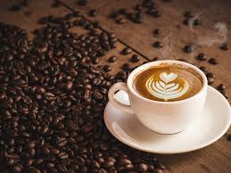
Coffee shops in TORONTO
AUTHOR: Oliver IGNETIK

Slide 2
CLIENT MOTIVATION
Opening a coffee shop in Toronto ?
Where is the best place to open a coffee shop ?

Slide 3



PROJECT SCOPE – FOCUS On VENUe distribution
FOURSQUARE API
Analysis of venues in each neighbourhood of TORONTO
Machine learning
cluster neighbourhoods into groups based on the prevalence of different venues
Recommend neighbourhoods with most potential revenue

Slide 4
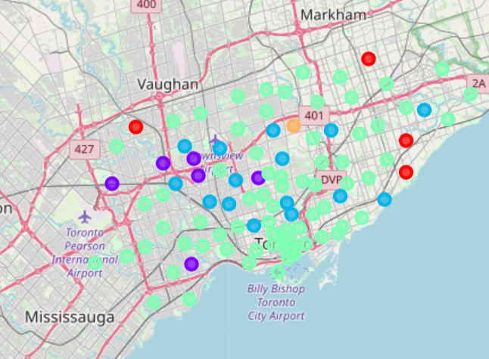
Favourable nieghbourhoods
Cluster 1 (red markers)
Food and restaurant districts
Low frequency of coffee vendors
High frequency of donut shops, diner and dessert shops
Cluster 2 (dark blue markers)
Workplace districts
Low frequency of coffee vendors
A lot of potential revenue from workers

Slide 5
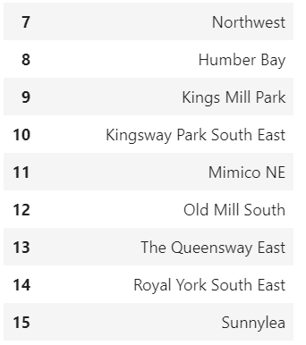
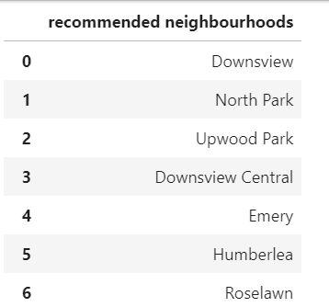
Recommendation
Low frequency of coffee vendors
Low frequency of bakeries, diners, dessert shops and donut shops
Potential revenue from workers during breaks

